Slide 1
Topic 1：Part I
Records
【See Chap.16 in the textbook】

Slide 2
Difference between array and record?
Array: the data must be ordered and homogeneous
Record(Structure): the data can be unordered and heterogeneous

Slide 3
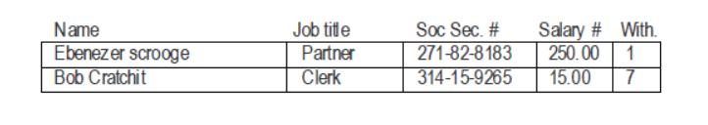
16-1 The concept of the data record
Example:
a record
a field(member): associated with a type, which may be different for different fields

Slide 4
16-2 Using records in C
Two-step process to create record data
Define a new structure type.
SYNTAX for defining a new structure type:
typedef struct {
field-declarations
} nwe-type-name;
Where:
field-declarations are standard variable declarations used here to define the fields of the structure
new-type-name indicates the name of the newly defined type
Example of a struct
typedef struct {
string name;
string title;
string ssnum;
double salary;
int withholding;
} employeeT;

Slide 5
Declaring structure variables
employeeT emp;
structure type
structure variables
General view
See the details
Different views of emp
emp
emp
name
title
ssnum
ssalary
withholding

Slide 6
Record selection
Record selection: refer to a specific field within a record
→ name of the complete record + a period + name of the field.
Example:
emp.titile
Initializing records
The dot operator returns an lvalue, which means that you can assign values to a record selection expression.
Example:
initialize a static global variable
emp.name = “Ebenezer Scrooge”;
emp.title = “Partner”;
emp.ssnum = “271-82-8183”;
emp.salary = 250.00;
emp.withholding = 1;
static employeeT manager = {
“Ebenezer Scrooge”, “Partner”; “271-82-8183”, 250.00, 1
};

Slide 7
Simple records
Record types can be useful even when they are simple
Example: represent a point as a single entity
typedef struct {
double x, y;
} pointT;
Procedures and functions that manipulate pointT values
pointT CreatePoint (double x, double y)
{
pointT p;
p.x = x;
p.y = y;
return (p);
}
initialize a variable of type pointT
pointT orighin;
origin = CreatePoint (0, 0);
A record can be assinged to another record, both records must be of the same type. rec1 = rec2;
Continue…

Slide 8
Records can also be passed as arguments to function
pointT AddPoint (pointT p1, pointT p2)
{
pointT p;
p.x = p1.x + p2.x;
p.y = p1.y + p2.y;
return (p);
}
call a function that takes a record argument, the value of the record argument is copied to the corresponding formal parameter.
change the value of the formal parameter or the value of any of its internal fields, the calling argument retains its original value.

Slide 9
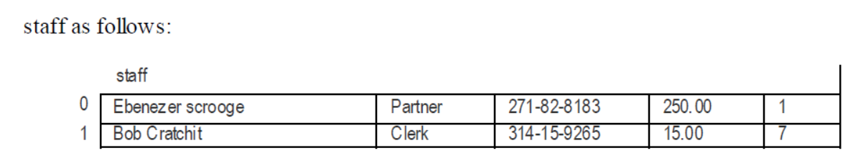
16-3 Combining records and arrays
declare staff to be an array of 10 employee
employeeT staff[10];
select the individual components of the staff
staff[1]
Question: How to select Bob Cratchit’s name?
staff[1].name

Slide 10
16-4 Pointers to records
variables that hold structured data in C are usually declared to be pointers to records rather than the records themselves.
A pointer is smaller and more easily manipulated
Pass a pointer to a record to a procedure, that procedure can change the contents of the record.
Pass the record itself, the record will be copied (just as an integer is copied), unable to make any permanent changes.
typedef struct {
string name;
stirng title;
string ssum;
double salary;
int withholding;
} employeeT;
employeeT *emp;

Slide 11
Defining a pointer-to-record type
typedef struct {
string name;
stirng title;
string ssum;
double salary;
int withholding;
} *employeeT;
Use of employeeT
employeeT emp;
a pointer
Question: define a variable as a record or a pointer to a record?

Slide 12
Allocating storage for record data
The compiler reserves space only for the pointer emp.
uses GetBlock to request enough storage to hold value of the type to which emp points
emp = (employeeT) GetBlock (sizeof *emp);
Another way of allocating space for a new record
emp = New (employeeT);
Call emp = New (employeeT);
emp
emp
name
title
ssnum
salary
witholding

Slide 13

Manipulating pointers to records
How to refer to an individual field if declared a pointer to the record?
*emp.salary
What’s wrong?
The selection operator takes precedence over dereferencing
→the above means * (emp.salary) rather than (*emp).salary .
C defines the operator -> so that it combines the operations of dereference and selection into a single operator:
(*emp).salary emp->salary

Slide 14
16-5 Building a database of records
Databases: Data structures that hold collections of structured objects—particularly when those structures are also stored in a data file.
typedef struct {
employeeT staff[MaxEmplooyees];
int nEmployees;
} *employeeDB;
The staff array, coupled with the number of active elements sorted in nEmployees, constitutes a simple database
employeeDB db;

Slide 15
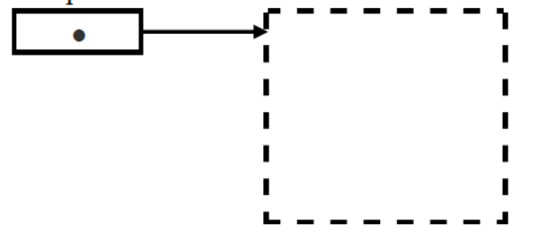

Creating the employee database
Example: employeeDB db;
At the highest level of detail, the database is simply a pointer to a record whose contents you do not yet have to understand:
db

Slide 16

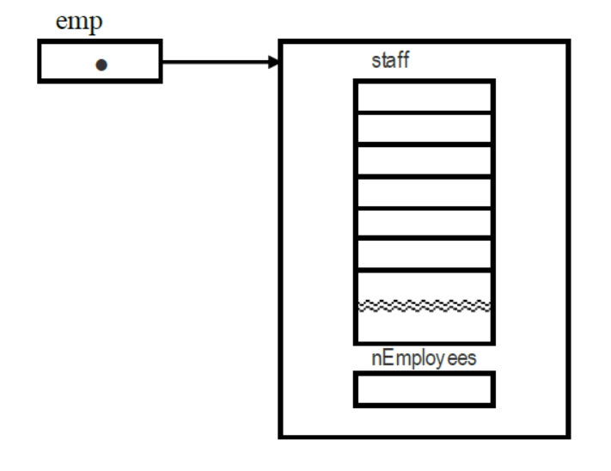

Look at the details of the employeDB record

Slide 17
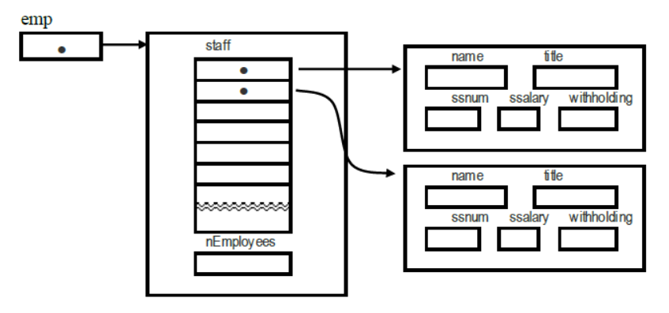
Finally, each of the elements in the staff array—according to the most recent definition of the type employeeT—is a pointer to a record

Slide 18

pseudocode
employeeDB db;
db = ReadEmployeeDatabase ();
/*ReadEmployeeDatabase can simply allocate the necessary storage internally*/
Details of two functions
static employeeDB ReadEmployeeDatabase (void)
{
employeeDB db;
employeeT emp;
int nEmployees;
db = New (employeeDB); /*allocate memory*/
nEmployees = 0;
printf (“Enter employee data (use blank name to stop).\n”);
while ((emp = ReadOneEmployee ()) != NULL) {
db->staff[nEmployees] = emp;
nEmployees++;
}
db->nEmployees = nEmployees;
return (db);
}

Slide 19
static emplyeeT ReadOneEmployee (void) /*The ReadOneEmployee function allocates*/
{ /* space for an employee and fills in its fields*/
employeeT emp;
string name;
printf (“Name: “);
name = GetLine ();
if (StringLength (name) == 0) return (NULL);
emp = New (employeeT); //allocate memory
emp->name = name;
printf (“Titile: “);
emp->title = GetLine ();
printf (“SSNum: “);
emp->ssnum = GetLine ();
printf (“Salary: “);
emp->salary = GetReal ();
printf (“Withholding: “);
emp->withholding = GetInteger ();
return (emp);
}

Slide 20
Using the database
static void ListEmployes (employeeDB db)
{
int i;
for (i = 0; i , db->nEmployees; i++) {
printf (“%s (%s)\n”, db->staff[i]->name, db->staff[i]->title);
}
}
static void GiveRaise (employeeDB db)
{
int i;
for (i = 0; i < db->nEmployees; i++) {
if (db->staff[i]->withholding >= 5) {
db->staff[i]->salary *= 2;
}
}
}

Slide 21
16-6 Designing a record-based application
Description: Write an application that makes it possible to present material in a programmed instruction style.
Ask the student a question
Get an answer from the student
Move on to the next question, the choice of which depends on the student’s response

Slide 22
Solution:
using database
Framing the problem
Designing the internal representation
Designing the external structure
Coding the program

Slide 23
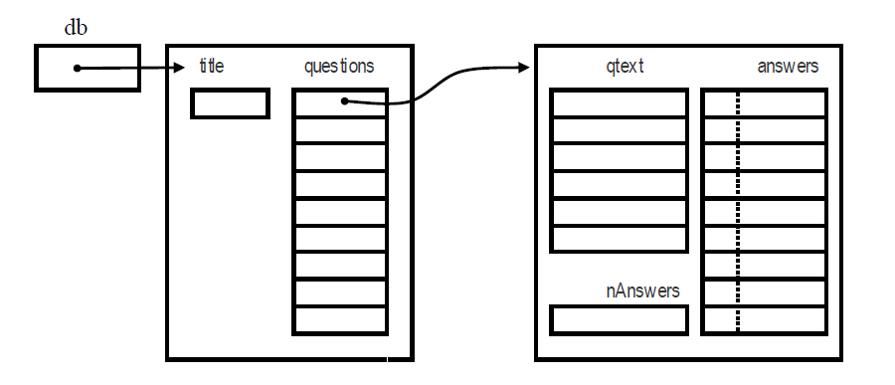
Designing the internal representation :
typedef struct {
string title;
questionT questins[MaxQuestions+1];
} *courseDB;
typedef struct {
string qtext[MaxLinesPerQuestion+1];
answerT ansewrs[MaxAnswersPerQuestion];
int nAnswers;
} *questionT;
typedef struct {
string ans;
int nextq;
} answerT;

Slide 24
Coding the program: Figure 16-1 teach.c
static courseDB ReadDataBase(void);
static bool ReadOneQuestion(FILE *infile, courseDB course);
static void ReadQuestionText(FILE *infile, questionT q);
static void ReadAnswers(FILE *infile, questionT q);
static FILE *OpenUserFile(string prompt, string mode);
static void ProcessCourse(courseDB course);
static void AskQuestion(questionT q);
static int FindAnswer(string ans, questionT q);
main()
{
courseDB course;
course = ReadDataBase();
ProcessCourse(course);
}

Slide 25
Home Works (要求完成2题）
PP593-600:Programming Exercises:
第一题: 16-2、16-5、16-7中选1题
第二题: 16-10

